Slide 1
Machine Safeguarding
Kartik Vashi
kvashi@schmersal.com
6 Steps to…
Turning Workplaces Into Safe Places®

Slide 2
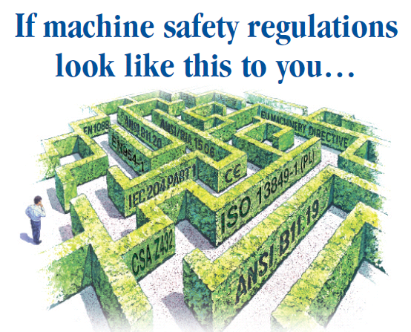
6 Steps to…
Turning Workplaces Into Safe Places®

Slide 3
Machine guarding
6 Steps to…
Turning Workplaces Into Safe Places®
Safety Audit / Risk Assessment
PSR (Pre Start Safety Review)
Safety Products Solution
Engineering And Installation
PSR Signing Off…
Training and Documentation

Slide 4
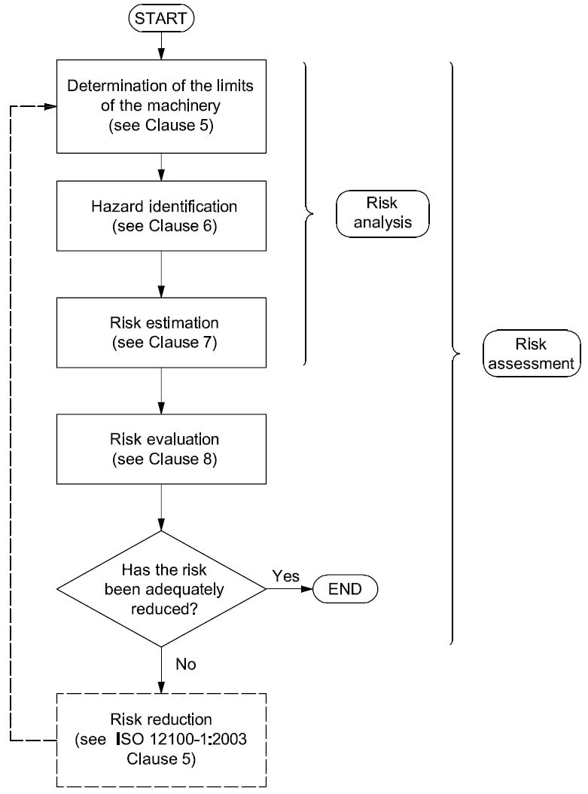
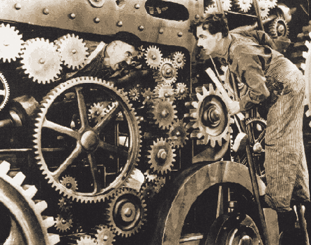
6 Steps to…
Turning Workplaces Into Safe Places®
Safety Audit / Risk Assessment

Slide 5
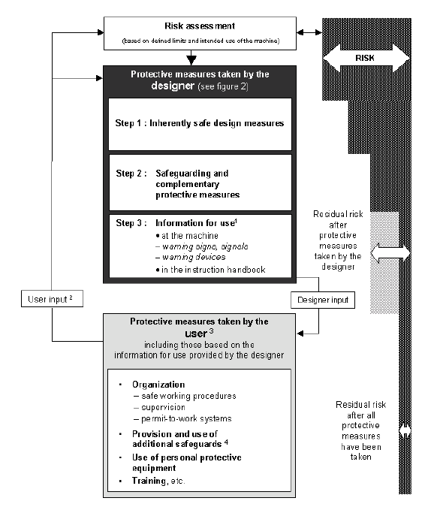
6 Steps to…
Turning Workplaces Into Safe Places®
Source: 12 100-1

Slide 6
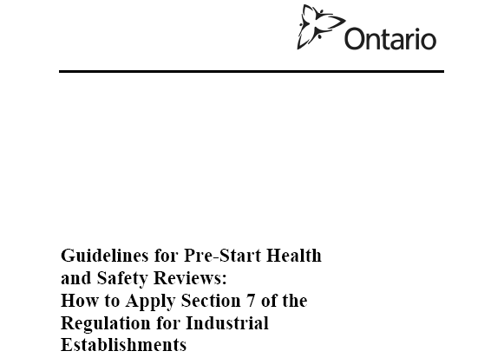
6 Steps to…
Turning Workplaces Into Safe Places®
Pre-start Review
A pre-start review is a written report that details measures taken to ensure that the construction, addition, modification and or installation of a new apparatus, protective element or process is compliant with current standards before production begins.
Pre-Start Health & Safety Review is a report written by a professional engineer** that details the measures necessary for compliance with applicable sections.
This is done at the design stage and the report will outline the steps needed for compliance. These steps or measures are to be completed by the employer before any production operation begins.

Slide 7
Safety Products Solution…
Safety Equipment
Separating
Non-Separating
Fixed
Movable
Approach/person detection
Localized
Movable
Fence, Barrier, requires tool
Doors, interlocked guards
Mechanical, Tactile
Electro Sensitive
Two-Hand Control
Emergency Off
Enabling Device
Safety Mat
Safety Edge
Safety Bumper
AOPD
Light curtain
AOPDDR
Scanner
PIPDS
Light beam
6 Steps to…
Turning Workplaces Into Safe Places®
Notes:
Ensure that everyone understands the difference in Seperating and Non-separating types of guarding

Slide 8
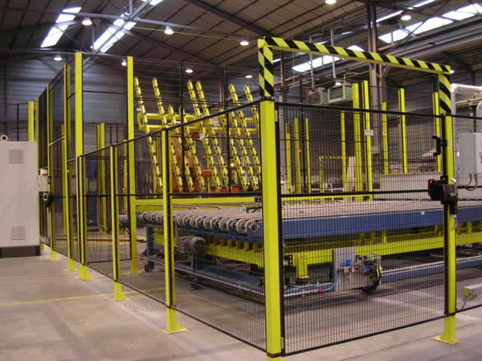
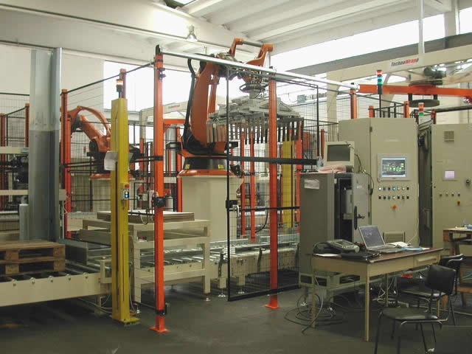
Engineering And Installation
6 Steps to…
Turning Workplaces Into Safe Places®

Slide 9
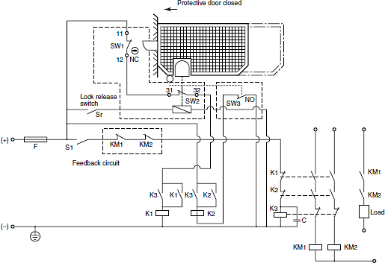
6 Steps to…
Turning Workplaces Into Safe Places®
PSR Sign Off…

Slide 10
Training and Information for the user…
Measures for risk reduction by the construction of the machine
(Direct Safety: design measures)
Constructive Measures
Everything Done?
no
Risk reduction by the use of technical safety devices and safety components
(Indirect Safety: technical measures)
3. Provide Information to the operator. Indication of remaining risks
(Indicative Safety: organisational measures)
Yes
Technical measures(Use of Safety Components)
Everything Done?
no
Yes
6 Steps to…
Turning Workplaces Into Safe Places®
Information for the user

Slide 11
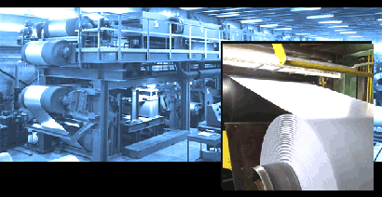
Real Life Example and Implementation
6 Steps to…
Turning Workplaces Into Safe Places®

Slide 12
Real Life Example and Implementation
6 Steps to…
Turning Workplaces Into Safe Places®

Slide 13
Thank you …
6 Steps to…
Turning Workplaces Into Safe Places®

